Slide 1

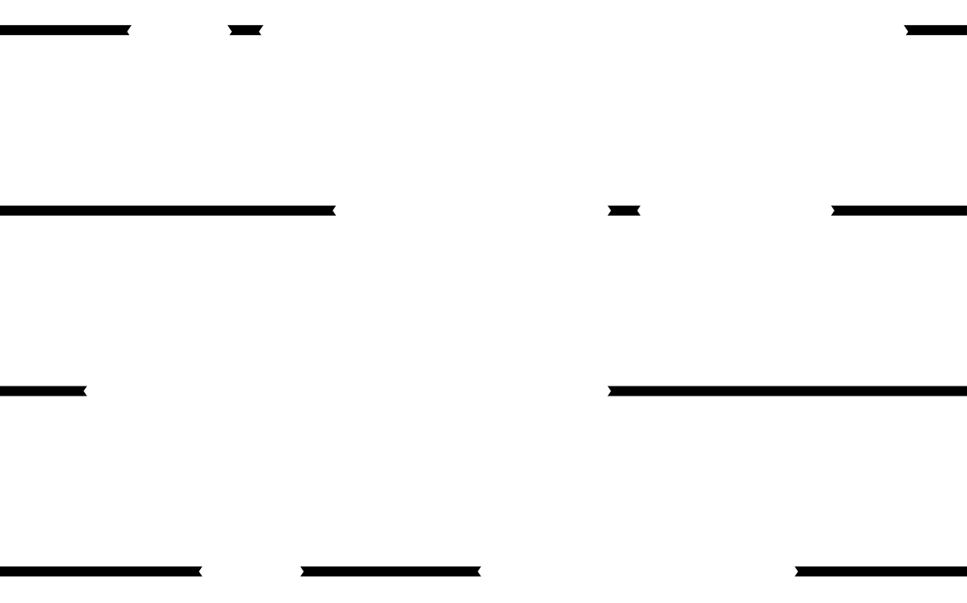


ECONIMATE
Where Economics comes to life.
Yukta Butala | Kelly Hong | Jason Yan | Victoria Ye | Yuchen Zhu

Slide 2

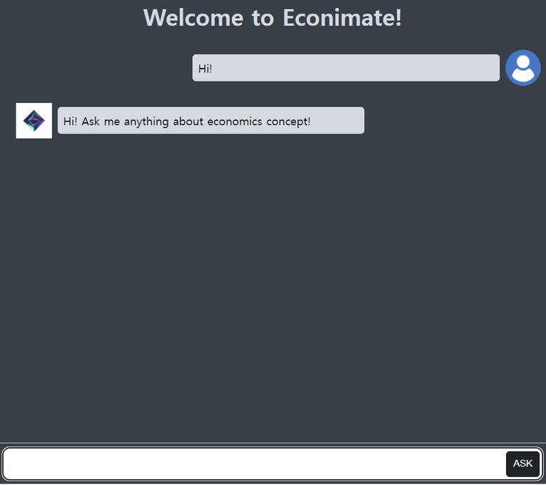

WHAT IS ECONIMATE?
Innovative AI Tutor simplifies economics for students, professionals, and anyone curious.

Slide 3
Support Students with Disabilities
Offer 24/7 Accessibility
WHY ECONIMATE
Concentration on One Specific Subject
Market Demand for Skill Development
Notes:
1. An AI tutor for Economics can be particularly beneficial for students with disabilities such as ADHD, by offering more interactive and engaging content and incorporating multimedia elements.
2. Students can access the AI tutor whenever they have questions or want to review concepts, providing flexibility in their study schedule, which is particularly valuable for students who may be studying economics as part of an online course or in a self-paced learning environment.
3. Econimate currently only offers Economics tutoring. Therefore, Focusing on one subject allows for a deeper exploration and understanding of its concepts.
4. There's increasing market demand to develop and expand skills in the field of economics or econ-related fields. Using Econimate will help students stay competitive

Slide 4







PROJECT ROADMAP
Output Text
Text
to
Audio
Audio
Input Prompt
GPT-4.0
Turbo
Video
Generator
Video
Econimate
Output Code
Code
to
Graph
Graph

Slide 5



PROMPT ENGINEERING
01
ASSUME IDENTITY
02
SPECIFIC GUIDANCE ON FORMAT
03
STEP-BY-STEP GUIDE
Asks the LLM to play the identity of an economics tutor.
Formatted in the form [Explanation], [Figure] for ease of integration.
Reduces hallucinations by the LLM.

Slide 6


You are an economic tutor. Explain economic concepts or answer economic questions in using figures and explanations for each part of the concept or question. The figures should be labeled [Figure - concept name] and the explanations should be labeled [Explaination - concept name].
At the start. All figures in the response should be displayed as either Python code for figures (graphs/tables/matrix/equations/more) or a specific prompt for the DALL-E API (ImageAPI) if no suitable image can be coded. Each explanation should refer to each and all of the figures and real-life scenarios. You can have multiple [Figure] and [Explanation].
Respond with 'This is not Economic related. Ask me anything about Economics instead!' if no economic concepts are mentioned.
Have the response displayed in the order of [figure - a], [explanation - a], [figure - b], [explanation - b], etc.

Slide 7



GPT-4 TURBO BEING THE BEST API
The success rate in testing multiple-graph video generation (10 test cases).
PALM 2
GPT-3.5 TURBO
GPT-4.0 TURBO

Slide 8




PRODUCT
INTEGRATION
Languages
Tools
Libraries
gTTS, moviepy, Matplotlib
Notes:
if you want to create an econimate of your own, you might need the tech stack including python, javascript, CSS, HTML, ChatGPT 4.0 Turbo, Amazon Elastic Compute Cloud, Flask and libraries not limited to gTTS, moviepy, Matplotlib and of course subject matter experts to train the model.

Slide 9


RISKS AND MITIGATION
4 to 7 minutes
Local System
Notes:
currently ecoimate takes 4 to 7 mins to get back to the user along with a video. It depends on the compute speed of the system on which econimate runs. We will make it faster and
runs in the local system, needs to have the computational power to use ecnimate. Move it to cloud

Slide 10





NEXT STEPS...
USER EXPERIENCE
SCALE
Notes:
not just this, we will also come up with a better user experience based on the feedback we get, to make econimate faster. Maybe we could come up with an mobile application so you could learn economics concepts from anywhere at any time
we want to replicate this model to other sectors as well. A tutor who can make school concepts easy to grasp, or help you learn a new language faster.
local server to the cloud

Slide 11




DEMO
Notes:
two amazing developers from our team built a demo for

Slide 12




QUESTIONS?
THANK YOU!

